Slide 1


Investigation of Vulnerabilities in Open RAN Implementations
Research Project – WS 22/23
Arnova Abdullah
Weekly meeting-08 (09.12.2022)

Slide 2
Previous Weeks Meeting Details
Week 1 Meeting (19.10.2022)
Basics about Radio Access Network (History, parts of RAN for 1G, 2G, 3G, 4G)
Basics about Open RAN (Distribution unit, central unit, user plane, control plane, interfaces, front haul, mid haul, backhaul)
Open RAN risk analysis (Stakeholders of attackers-User, external attacker, cloud operator**, RAN operator**)
Week 2 Meeting (26.10.2022)
Installation of Kali Linux and Metasploitable
Atomic Red Team GitHub repository download
Research other open-source attack tools
Week 3 Meeting (02.11.2022)
Penetration testing using Kali Linux
Try Atomic tests by invoke-atomic
Get used to commands used for running a test
Research details about one of the attack tools - Infection Monkey
Read research papers on the risk of 5G open RAN
Week 4 Meeting (09.11.2022)
Finding the most relatable attacks from the MITRE ATTACK list (On going)
CyberOps course ongoing
Research paper by MOU

Slide 3

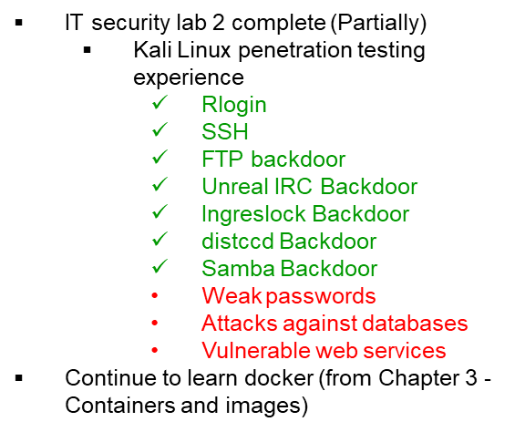

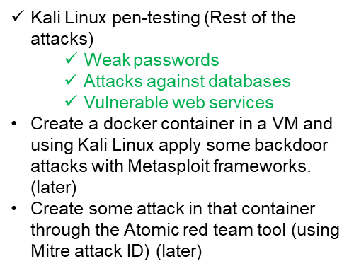
Previous Weeks Meeting Details
Week 5 Meeting (17.11.2022)
Install Infection monkey (Need AWS subscription, don’t continue anymore!!)
Start learning Docker container
https://developer.cisco.com/learning/tracks/containers/
https://learning.oreilly.com/videos/docker-fundamentals-for/9781803237428/9781803237428-video1_1/

Slide 4
Week 8 (Until 08.12.2022)
Make a comparison between Kali Linux tools and Atomic Red Team
Select one to use at the end of the project
Research
How to attack the docker container?
How to attack OS (Ubuntu 18)?
How to attack open RAN components or interfaces?
What are the components and interfaces of open RAN?
Search for the known vulnerabilities in CVE list/NIST/exploitdB

Slide 5
Comparison between Atomic Red Team and Kali Linux
Atomic Red Team | Kali Linux
Atomic Red Team is an open-source library of simple tests that every security team can execute to test their controls and to simulate adversarial activity in their environments. | Kali Linux is an open-source, Debian-based Linux distribution aimed at advanced Penetration Testing and Security Auditing
Atomic tests (200 different attack techniques) are mapped to the MITRE ATT&CK matrix, so you always know which techniques you do and don’t detect. Every technique in the “atomics” directory is labeled with an ID that corresponds to MITRE ATT&CK. | Kali Linux provides more than 600 penetration testing tools targeted toward various Information Security tasks, such as Penetration Testing, Security Research, Computer Forensics, Reverse Engineering, Vulnerability Management, and Red Team Testing.
Atomic Red Team can run via command prompt or its execution framework, Invoke-Atomic, which is compatible with all operating systems that support PowerShell. | Kali Linux tools can be run in the command prompt or with the msfconsole.
MITRE ATT&CK is a globally-accessible knowledge base of adversary tactics and techniques based on real-world observations. There are 3 matrices: enterprise, mobile and ICS. These matrices contain tactics (the reason for performing an action) and techniques (how to perform an action). | Some important tools in Kali: Nmap, OpenVAS, Fierce: Network discovery Lynis: Security auditing and compliance testing Hydra, John the Ripper, findmyhash, RainbowCrack: password cracking tool Metasploit: Testing known exploit Nikto, Skipfish, Burp Suite Scanner, BeEF, FunkLoad: Web security attack tools King Phisher: Phishing attack Yersinia: Layer 2 attack SET: Social Engineering attack T50, SlowHTTPtest: DOS attack Inundator: IDS Security evasion tool

Slide 6
Comparison between Atomic Red Team and Kali Linux
Option 1:
To work with Atomic Red Team as it has all types of attack use cases according to known vulnerabilities.
Problem: Need to install some additional tools (ex: Nmap)
Option 2:
To use Kali Linux tools for attacking docker, ubuntu
Problem: No known vulnerability testing
Option 3:
Installing atomic red team in Kali Linux OS (not sure!) so that no additional tools are required to be installed

Slide 7
Research
CVE List:
https://www.cvedetails.com/vulnerability-list/vendor_id-4781/product_id-20550/opginf-1/Canonical-Ubuntu-Linux.html
https://cve.mitre.org/find/search_tips.html
I didn’t find anything for open RAN. But there are some rules for searching with keywords. I will research and find this.

Slide 8
Next Steps (Week 9) (Until 15.12.2022)
Create a list for Docker, and Kubernetes attack:
How to attack the docker container?
What are the tools? (If required any)
What are the known vulnerabilities? (CVE, MITRE)
Create a list for Ubuntu:
How to attack Ubuntu?
What are the tools? (If required any)
What are the known vulnerabilities? (CVE, MITRE)
Try to install Atomic red team in Kali Linux

